Slide 1




Student Record Management System
Shimaa Esaeed

Slide 2
System vision
Systems for students
Any student can easily select his courses that taught with very professional teachers with huge experience .
Teachers are full time available for helping
Hard-working teachers +Great assistant =students success
z

Slide 3

System components
z
-Profiles class
-students class
-new student class
-teacher class
Center place class
Assistant class
Courses class

Slide 4
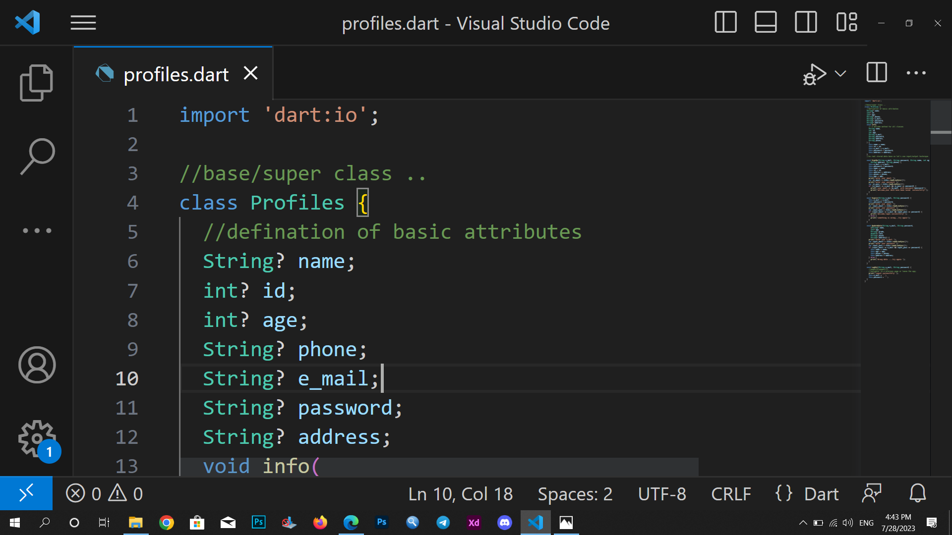
Profiles class
z
It's a base /super class that contains basic attributes and methods
Like :
-Name , id , e-mail , password , phone ,address ,age
That data supposed to be stored in a local data base or used with API link .
Student ,teacher ,assistant inherit this super class [each one is single inheritance ]

Slide 5
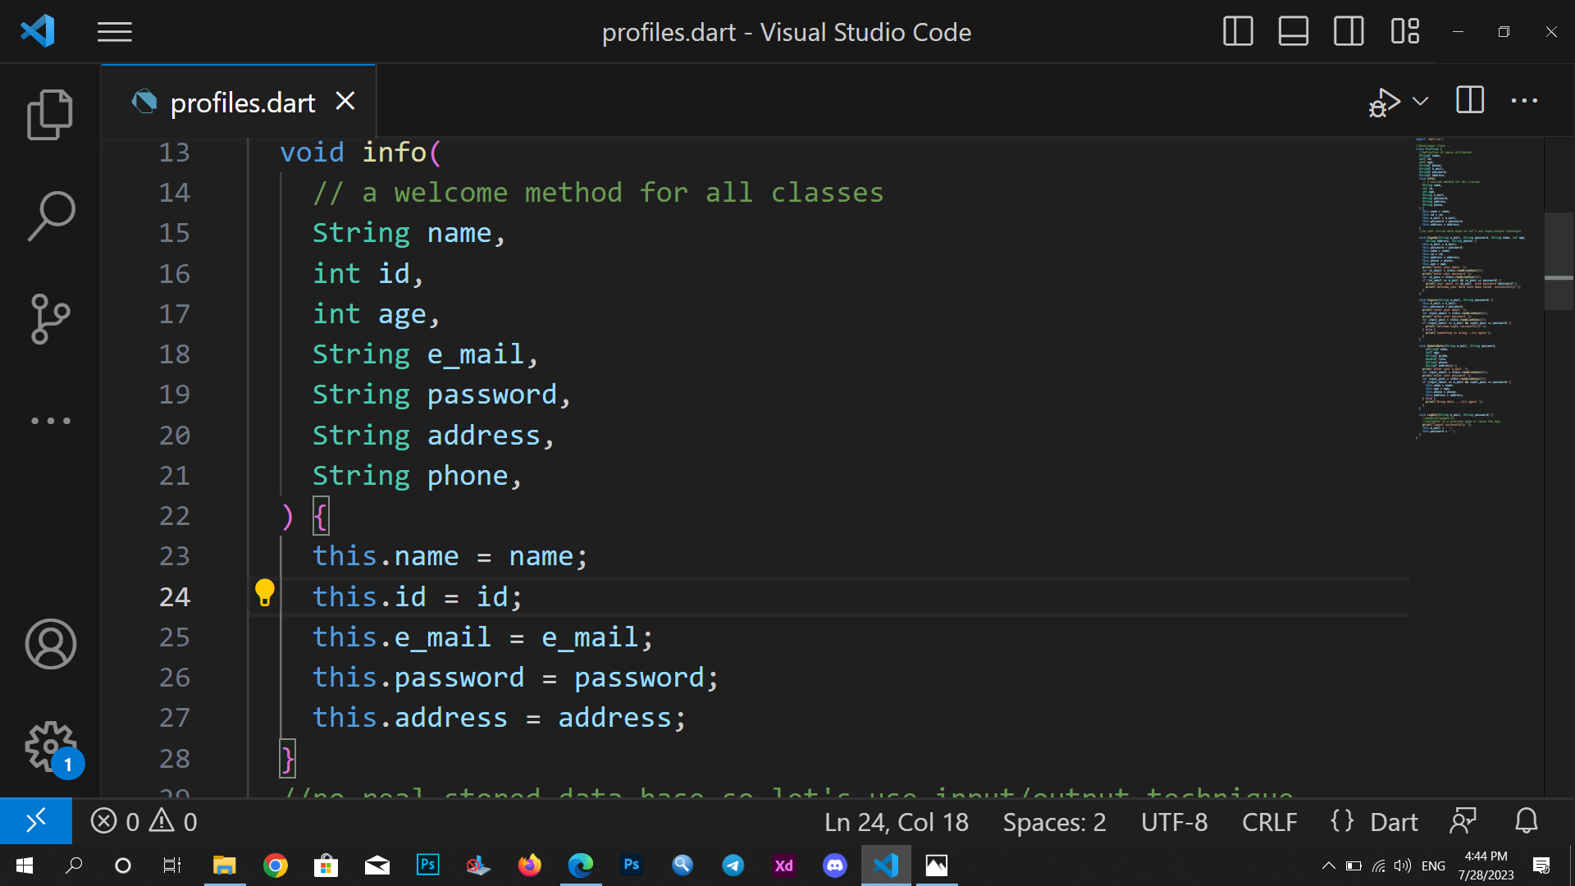
-info () .
Show personal information about its person.
z

Slide 6
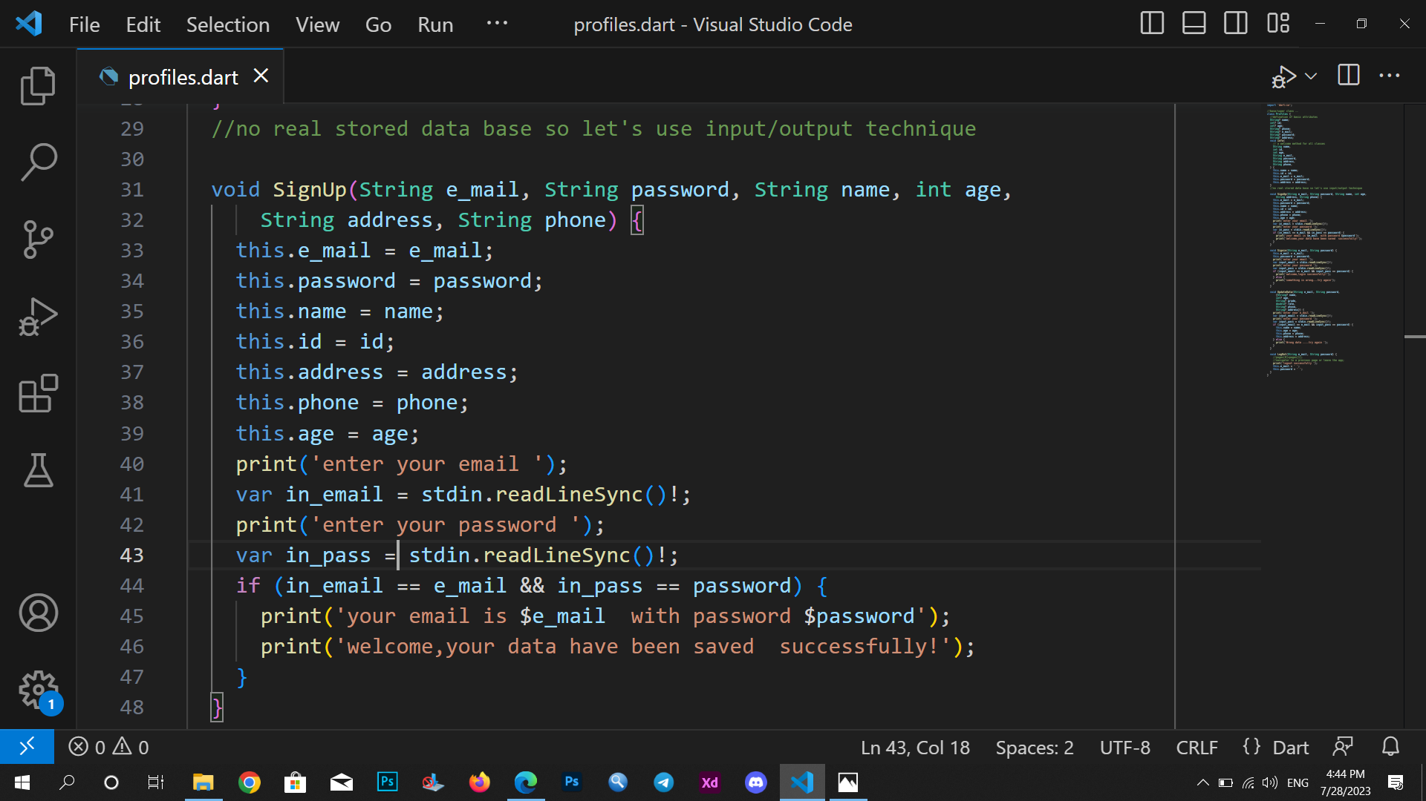
Sign up method
For his first enter to save data
z

Slide 7
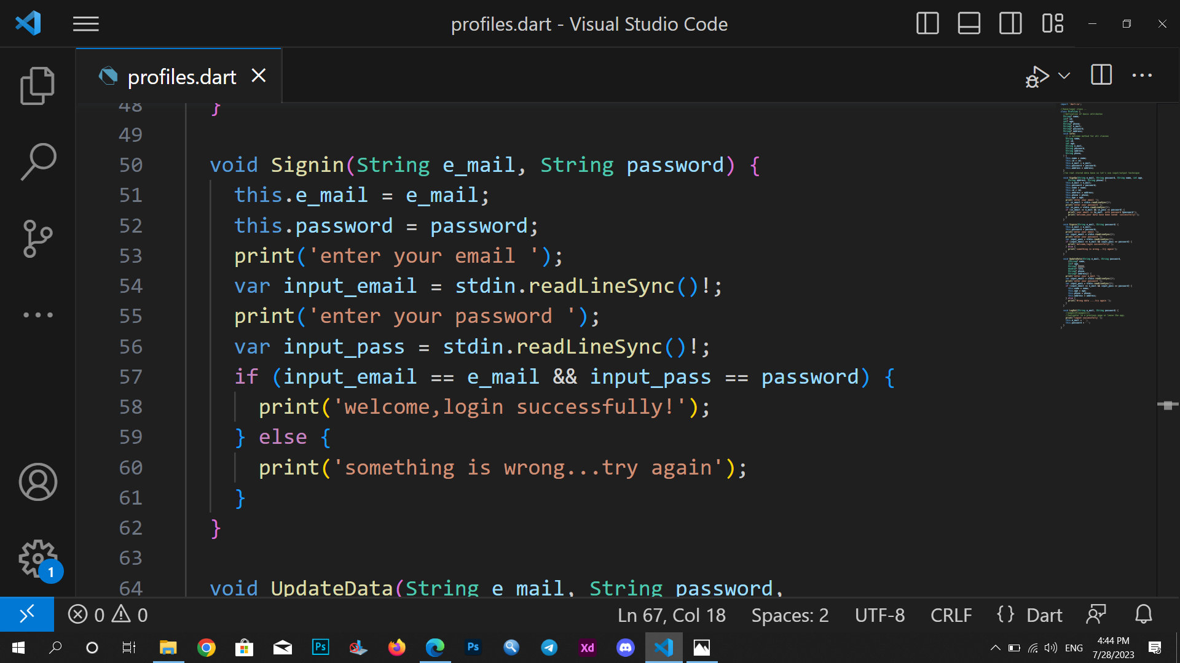
z
Sign in ()

Slide 8
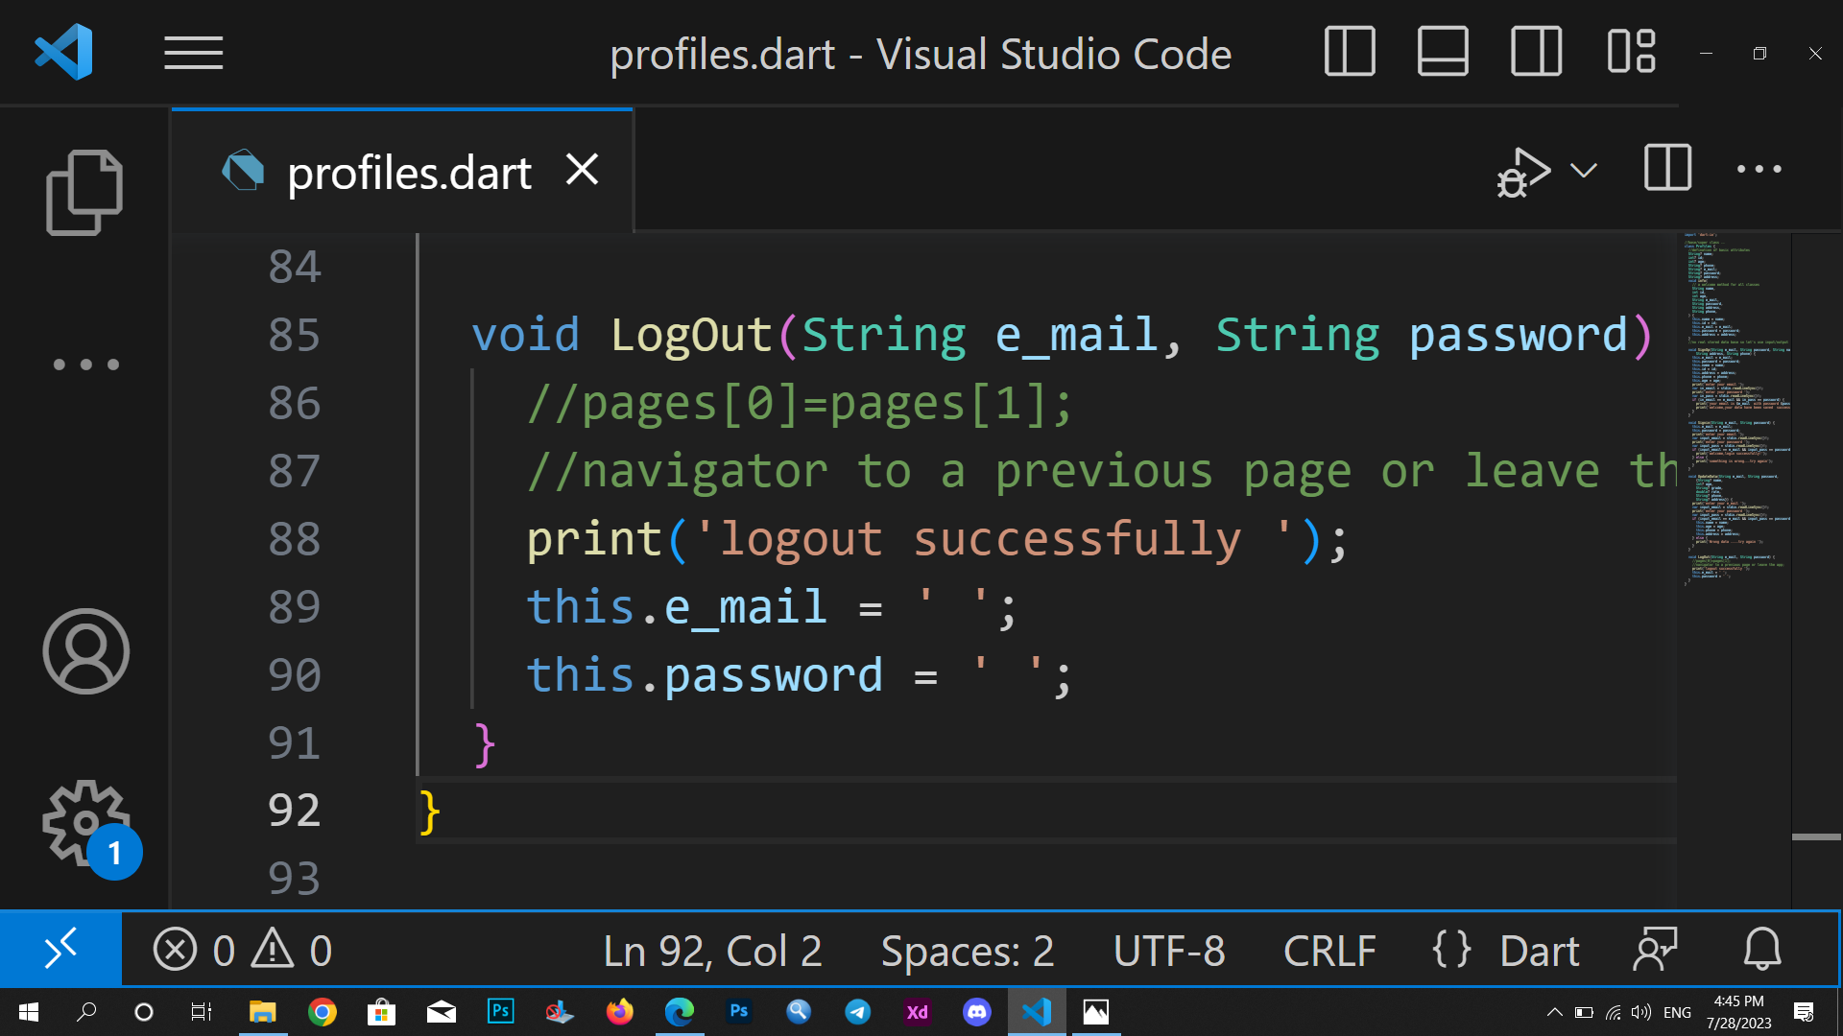
z
Log out ()

Slide 9
Students class
Student enters his information like his name ,his grade ,his phone ..email ,password for his account .
After he successfully login …..he if forwarded to courses page.
-he can select his course and write down its time .
He can also update his data &&log out if wanted .
-He can rate his teacher after the course ended .

Slide 10
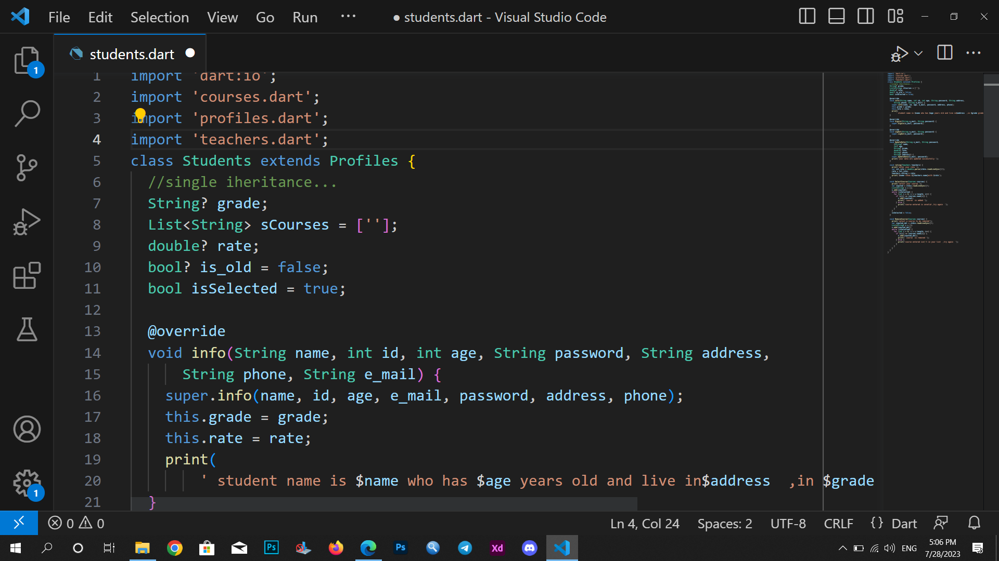
z
Student intro

Slide 11
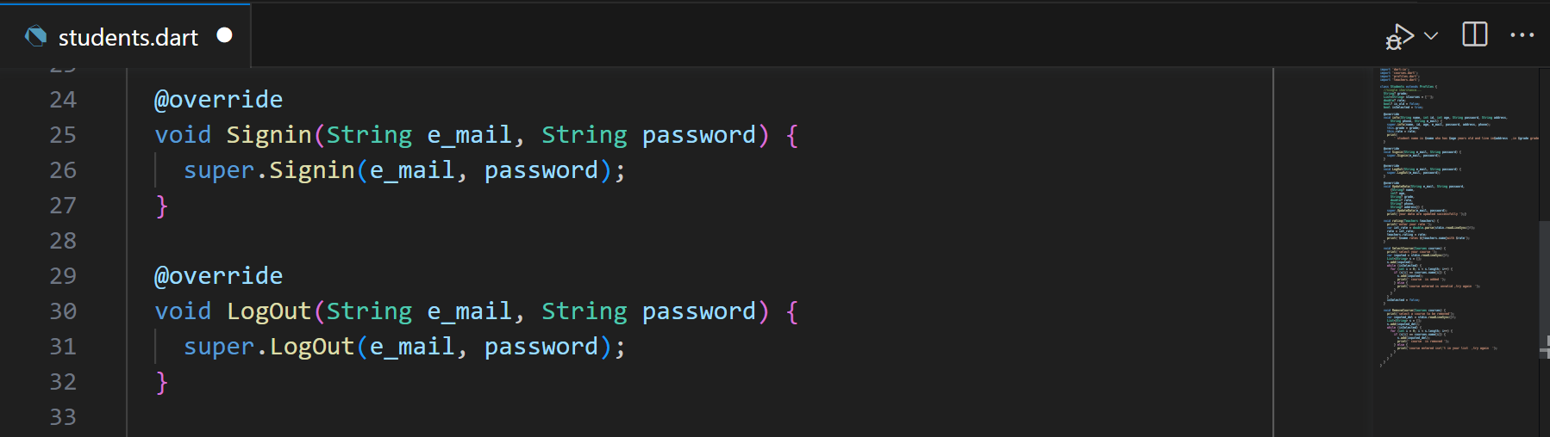
z
Sign in (), logout() in sub-class
Polymorphism examples .

Slide 12
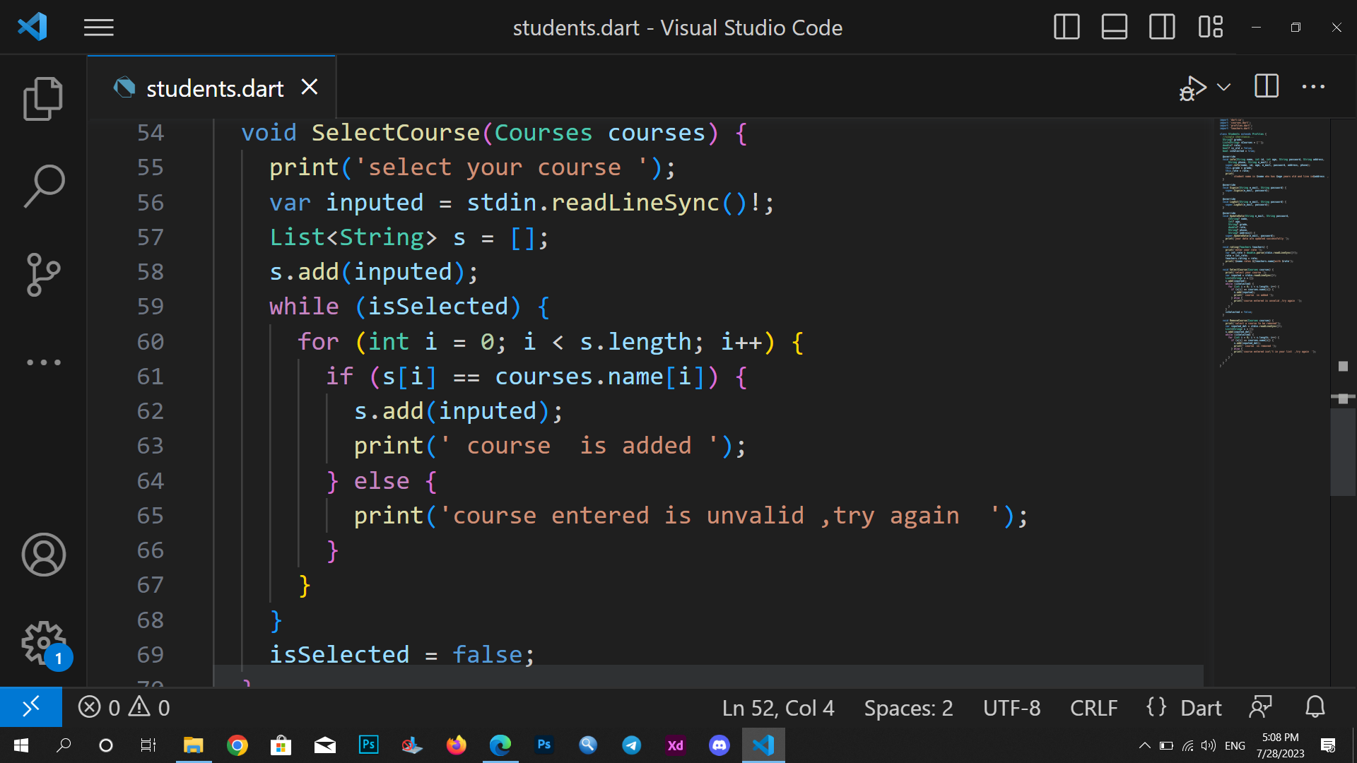
z
Select course ()

Slide 13
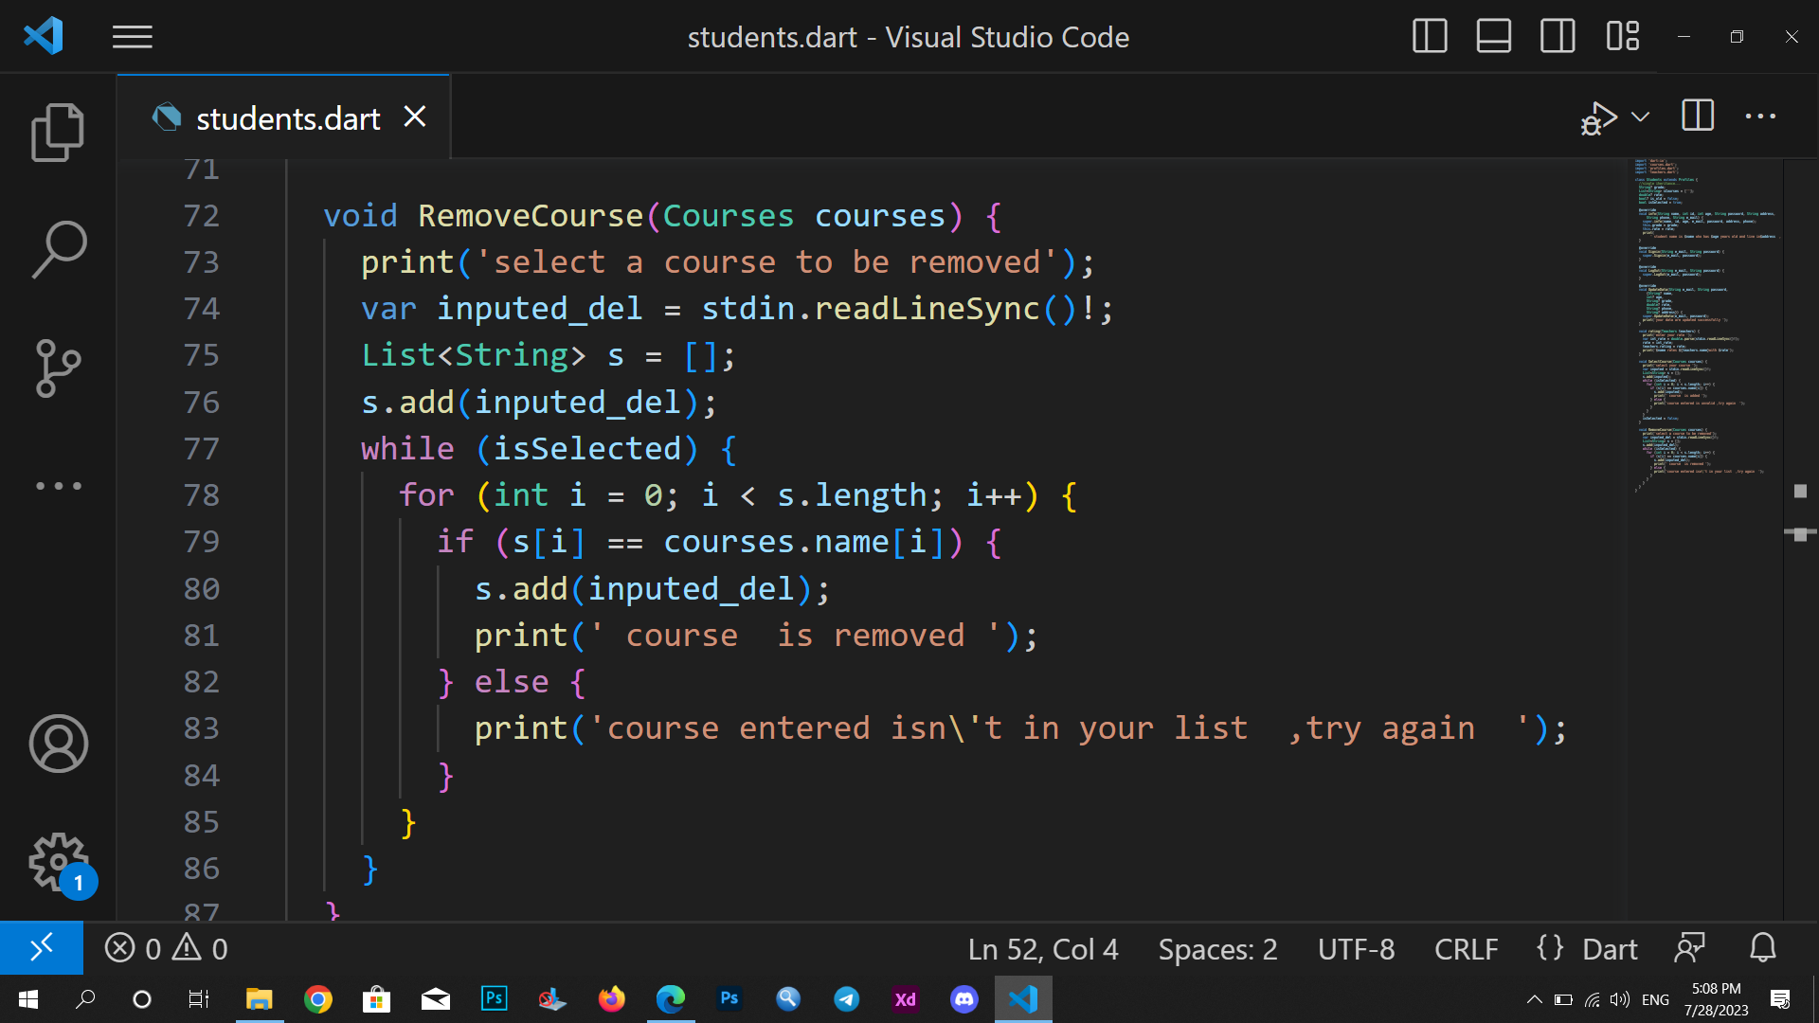
z
remove course ()

Slide 14
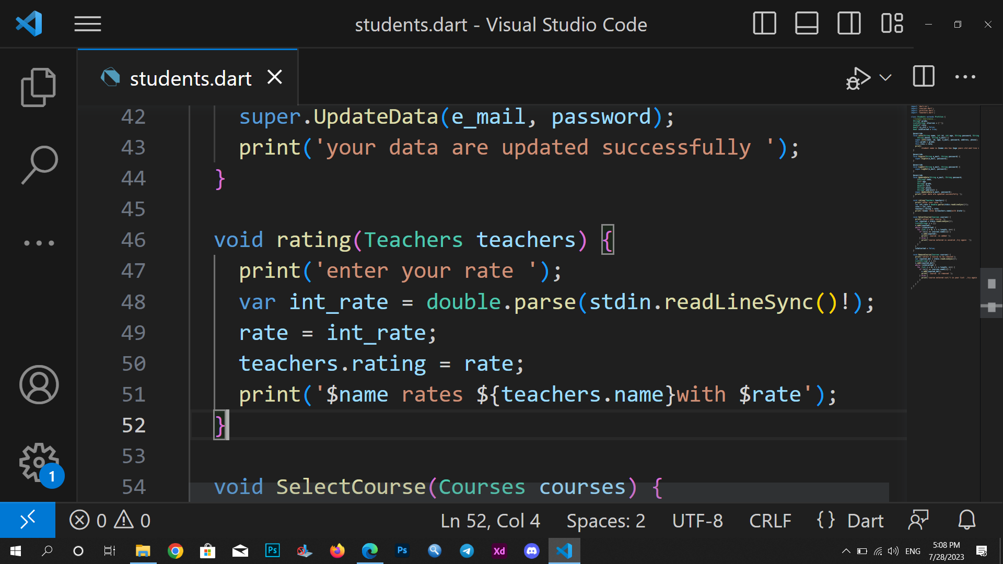
z
Rating teacher()

Slide 15
New Students class
New student doesn't have an account before so he have to sign up
When signing up he enters his data like [name, id ,phone ,email, password, address, ]
He should login to be treated like old students and check his data have been saved correctly.
After being aHe select ,add, remove courses .
-also update his data
He can logout
z

Slide 16
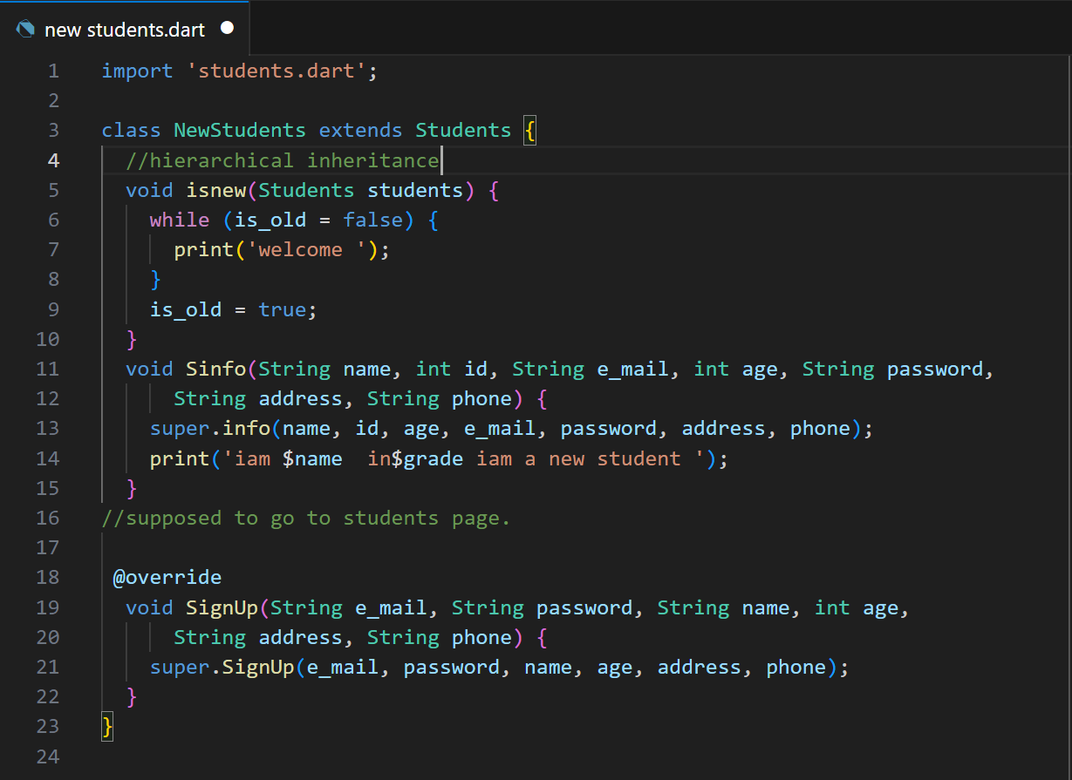
New student
z

Slide 17
teacher class
-teacher enters his datalike : name ,id ,email ,phone , graduation date-university-department , # experience years , rating of last course to welcome his students in an info methods .
He have permission to :[-add courses ,delete courses ,Add or delete a sessions dates for existed courses ]

Slide 18
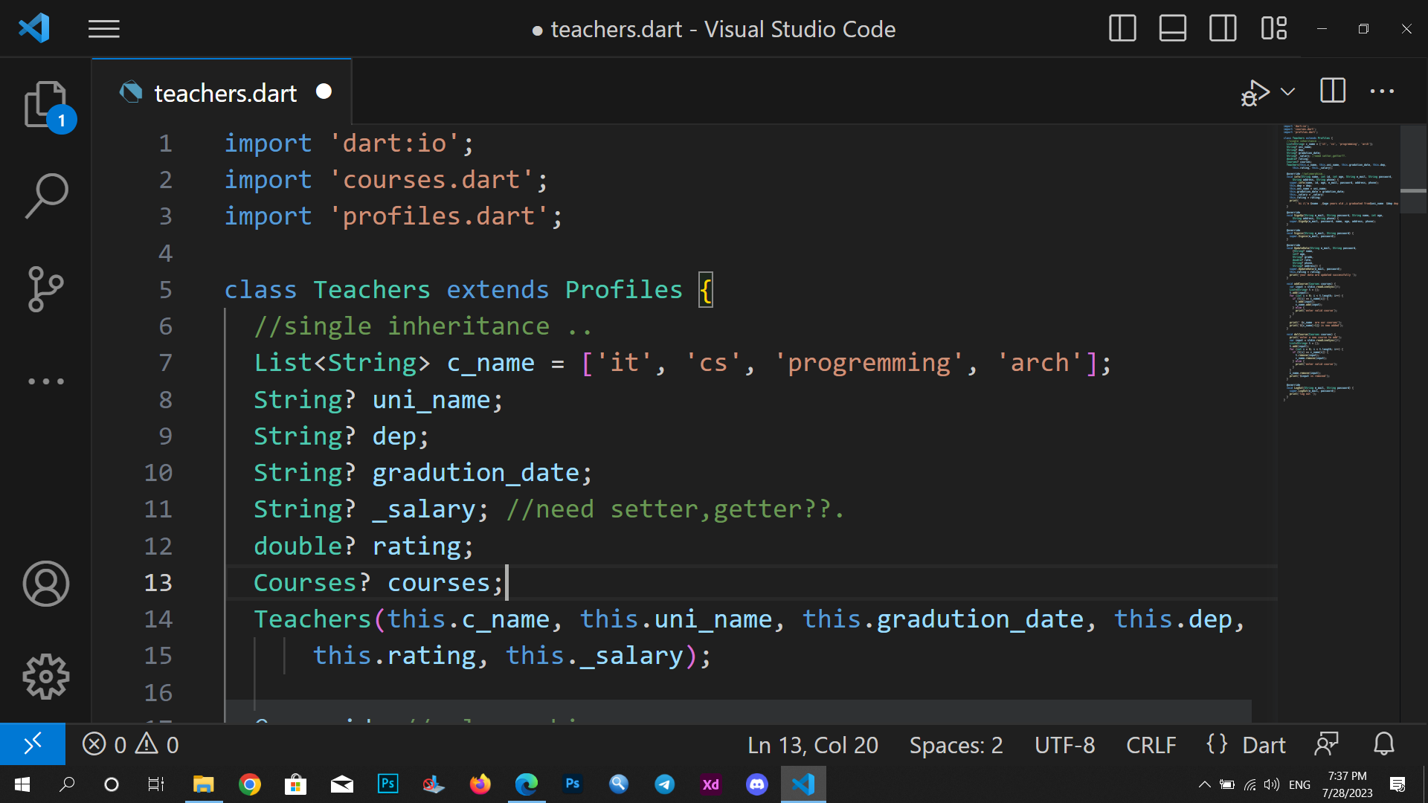
Teacher attributes
z

Slide 19
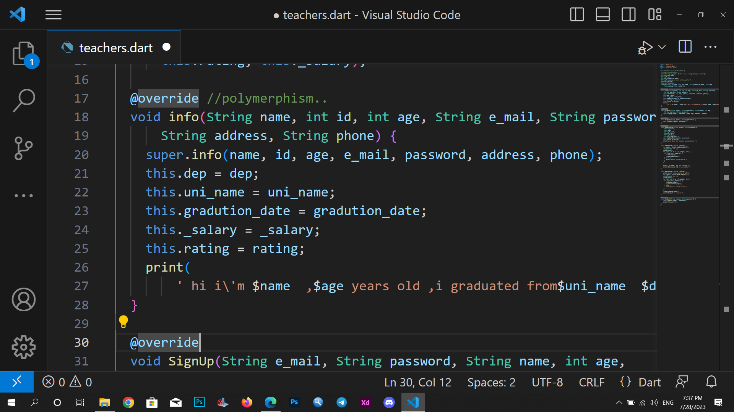
Info ()..
z

Slide 20
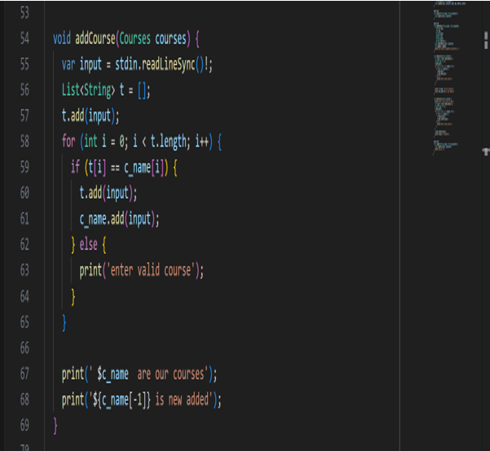
Add course()
z

Slide 21
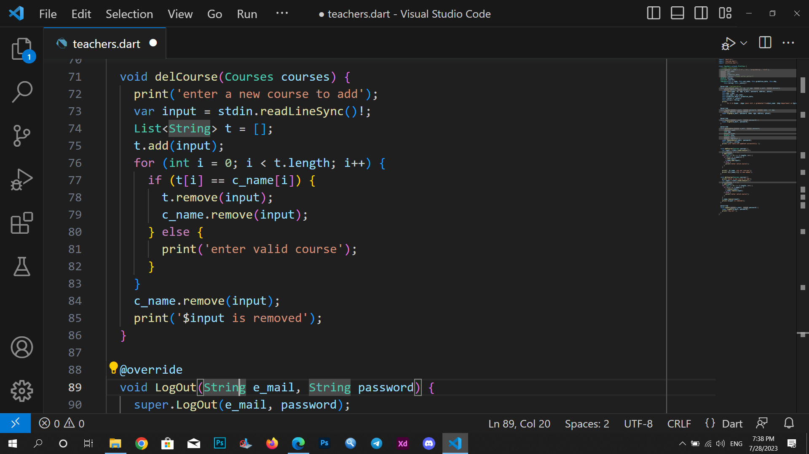
Remove course()..
Sign in ,sign up ,log out as slide :
11,16
z

Slide 22
Courses class
That class shows courses attributes like course name, id ,date ,start time ,length ,location by room id ,price ,rating of its instructor
Within this class course location can change from update-place()
Course is available or not is shown

Slide 23
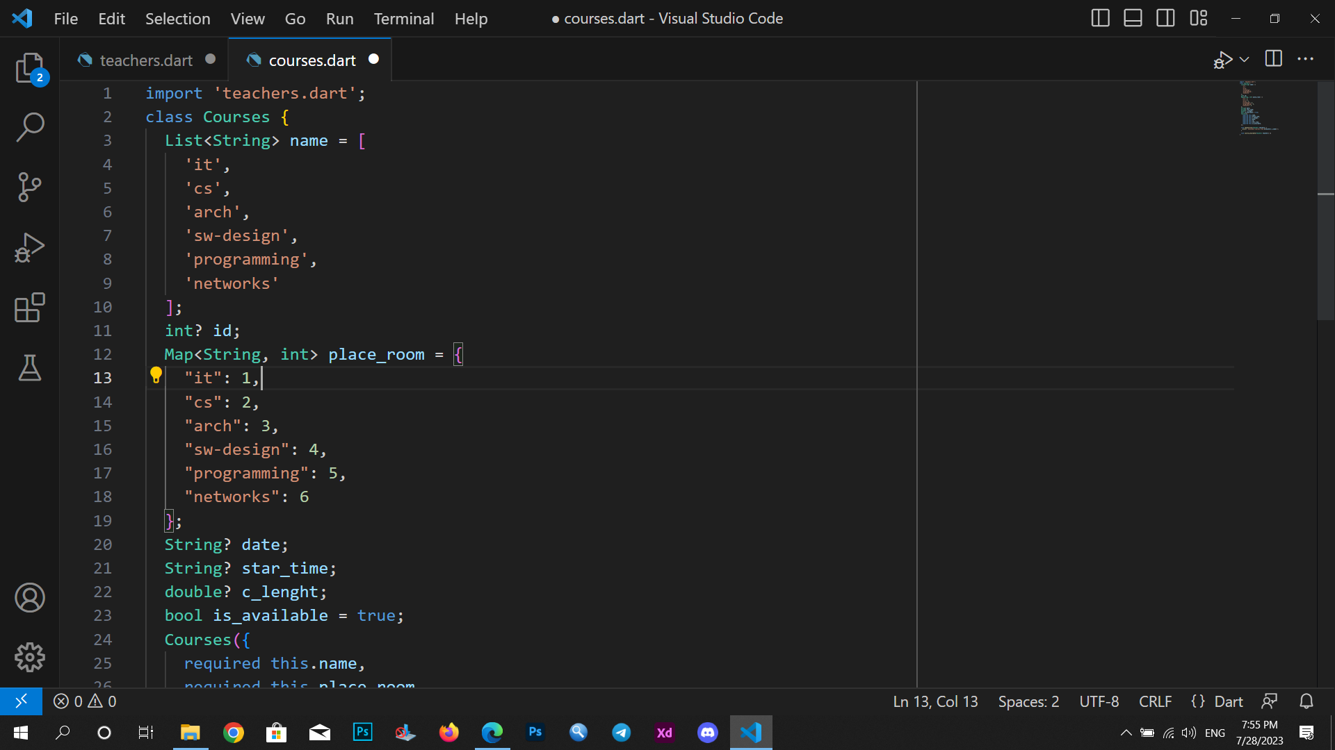
Courses attributes
z

Slide 24
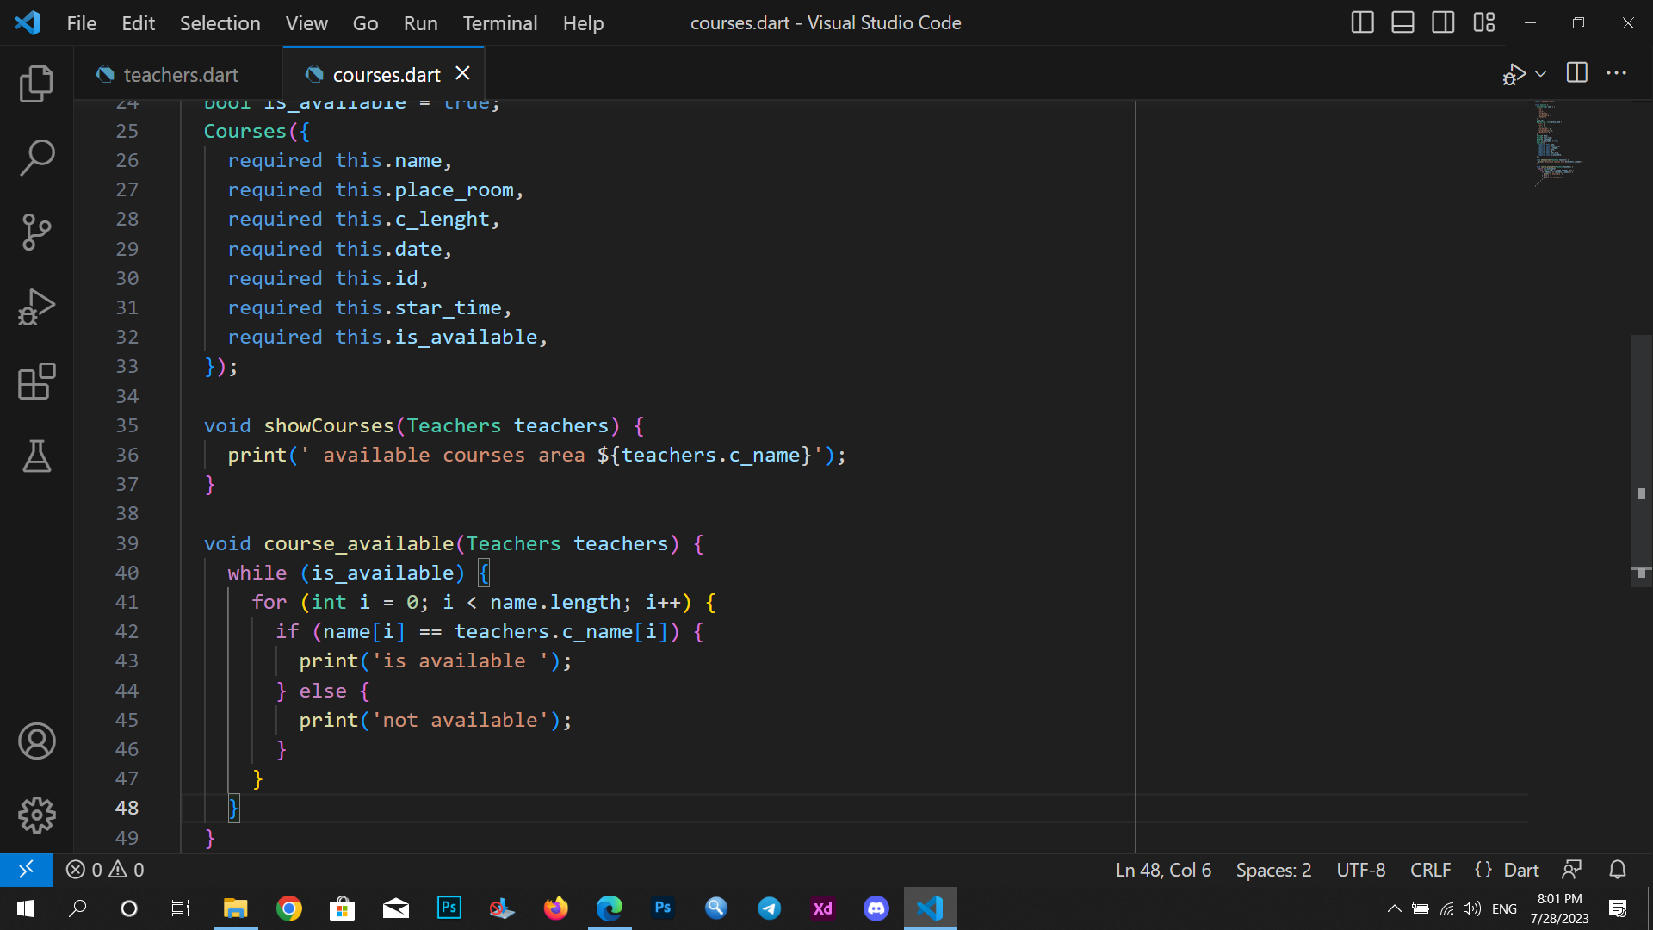
Show all courses
Show if the course is available
z

Slide 25
Center-place class
That class shows center attributes like place name, id ,location ,# rooms , rooms id , all provided courses name .
Within this class firstly a welcoming method is shown with some info about the place .
Shows available rooms for courses
z

Slide 26
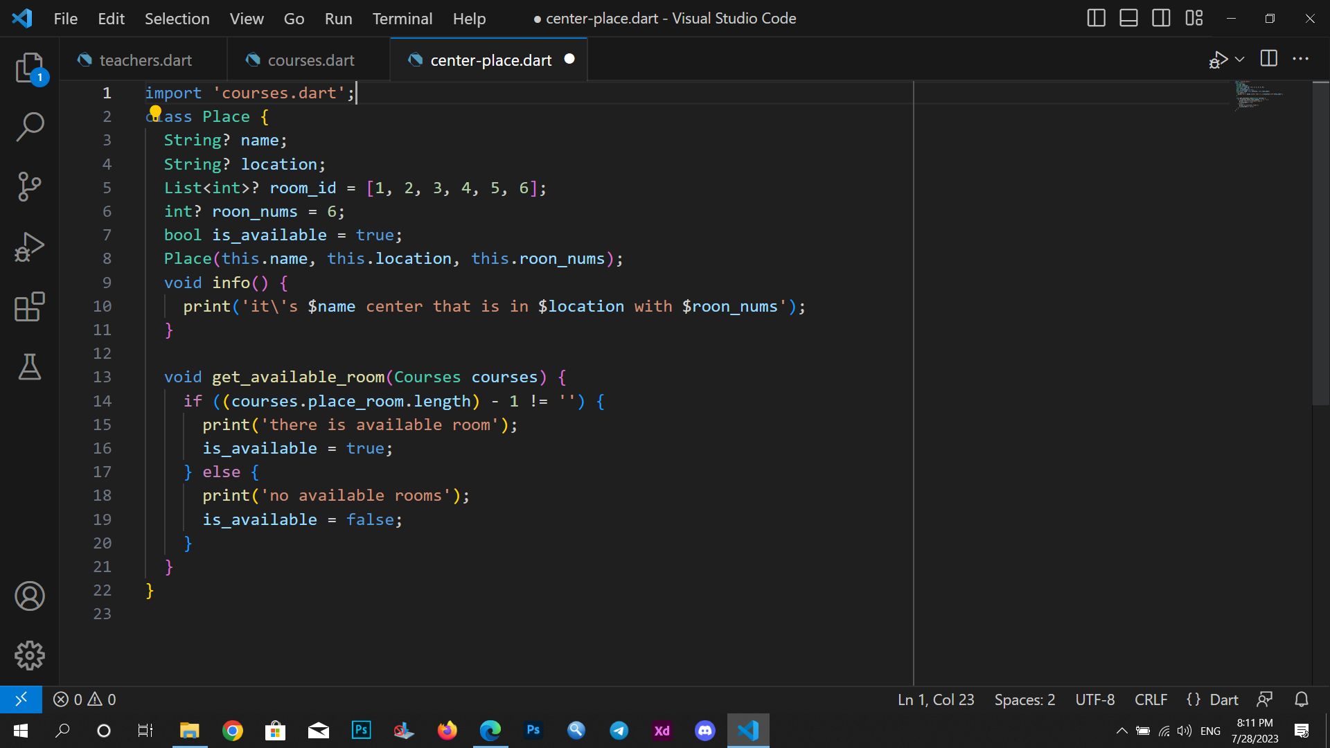
Class attributes welcome () method that available rooms
z

Slide 27

Thank you
Shaimaaesaeed#5757

